Slide 1
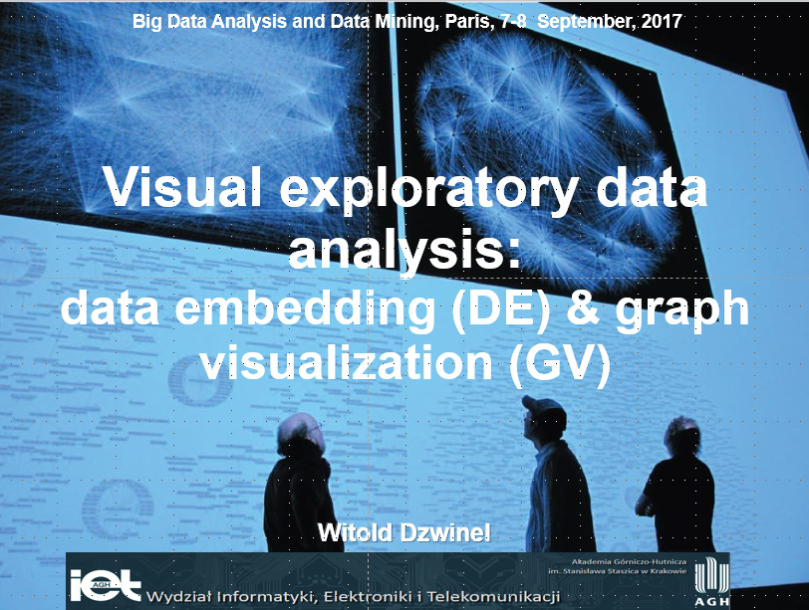

Slide 2
Classes organization
1. Sunday (May, 17th) (4 hours) - visualization of small data sets (Orange, soft).
2. Sunday (May, 31st) (4 hours) -- visualization of large data sets and graphs (ivta, Gephi, ivga).
3. Credit: one task → one A4 page report: one (two) images and synthetic conclusions

Slide 3
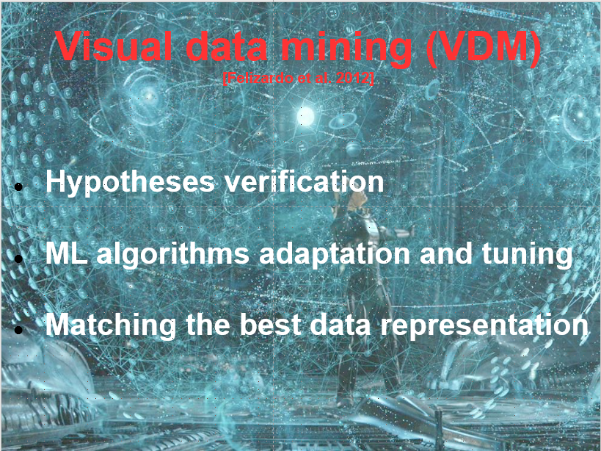

Slide 4
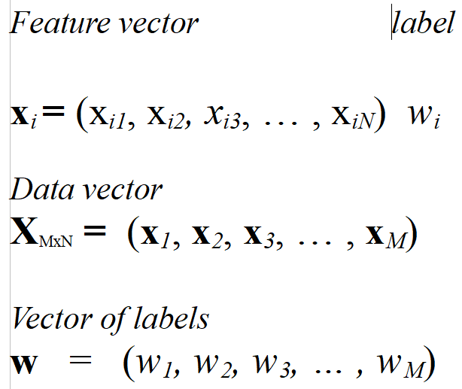
Vectors→data representation

Slide 5
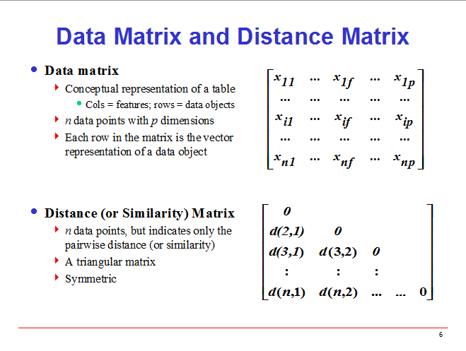
Notes:
5

Slide 6
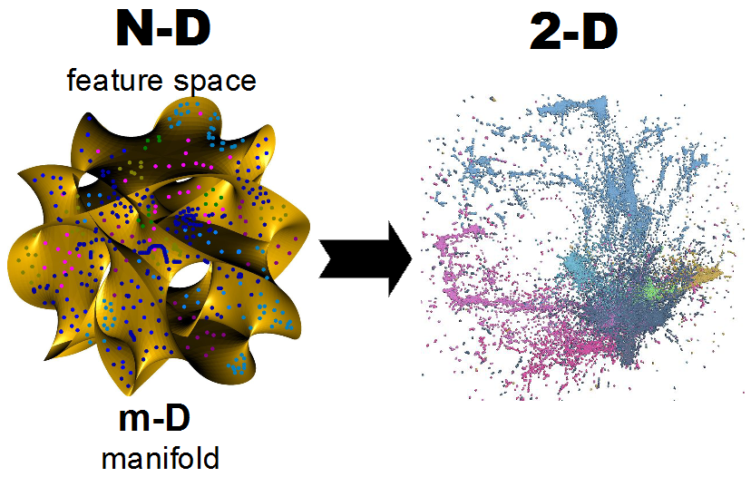
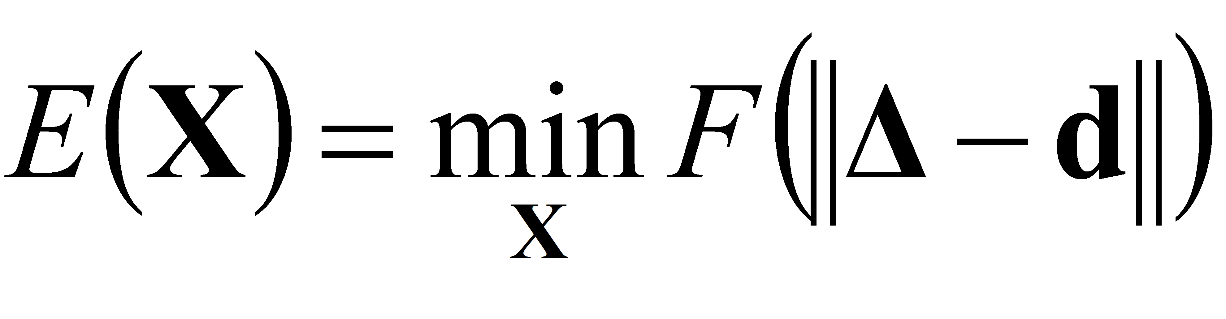
Topic → interactive visualization via embedding of large high dim data

Slide 7
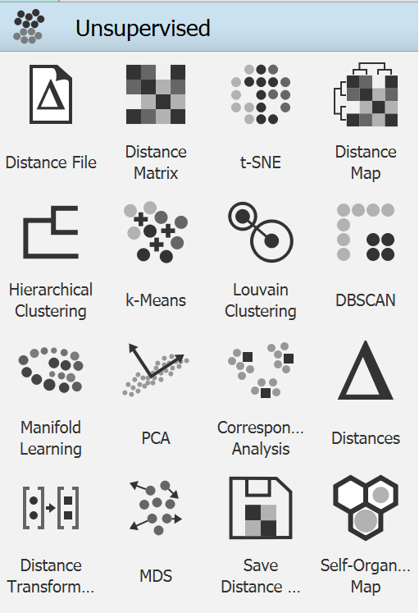
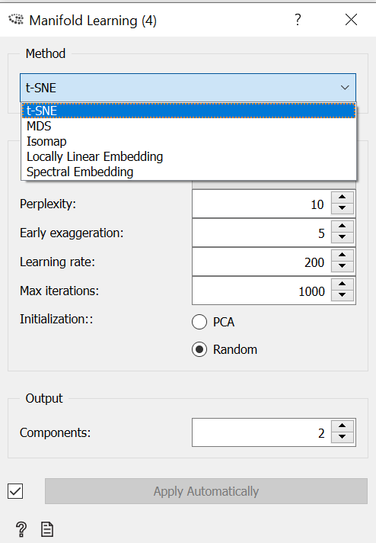
Multidimensional data
visualization

Slide 8
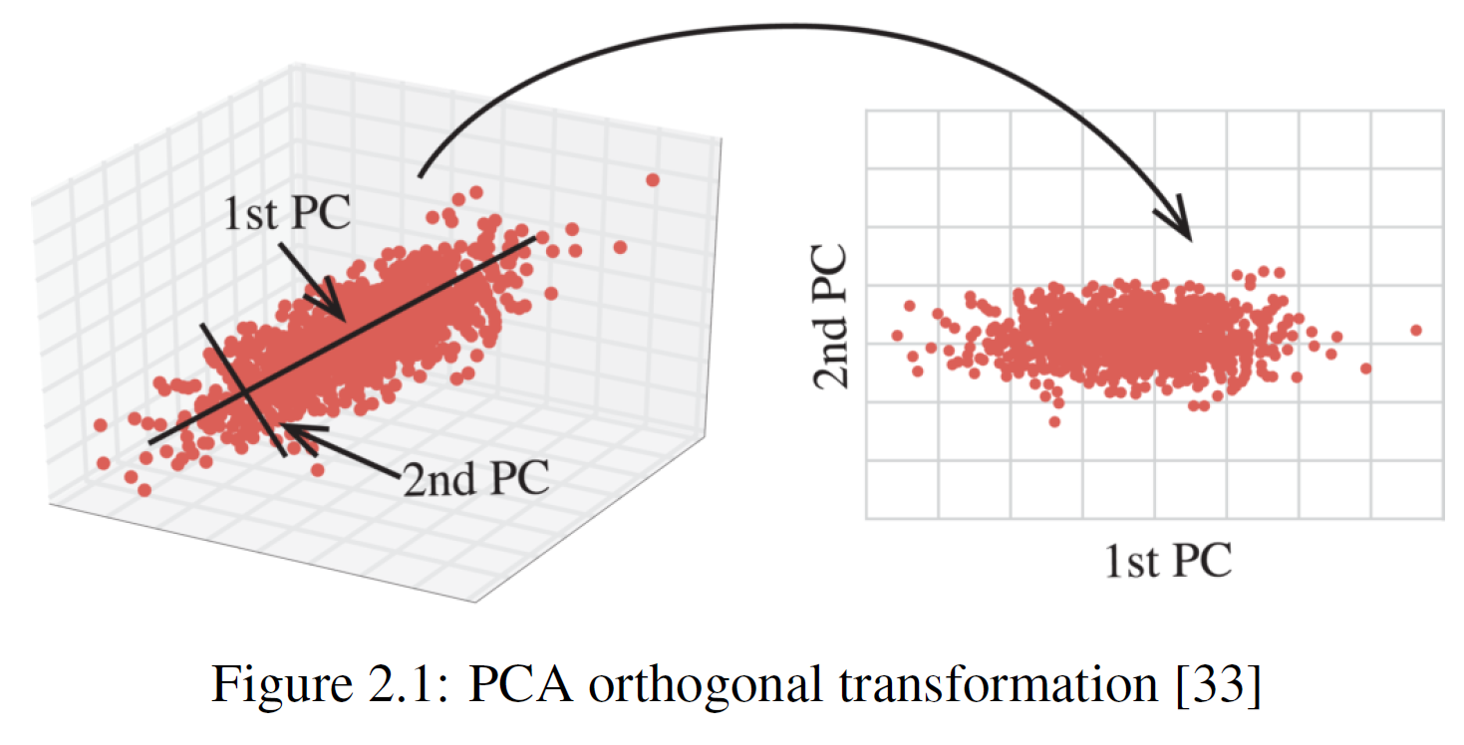
Principal Component Analysis

Slide 9
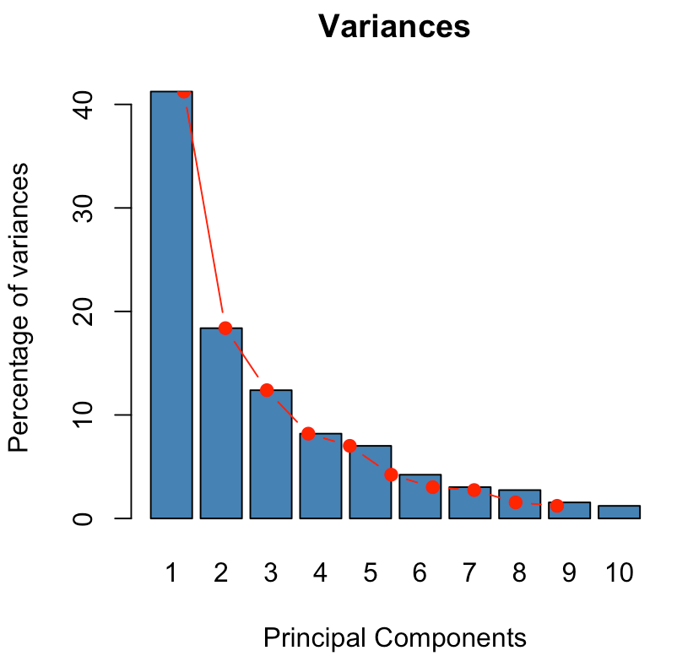
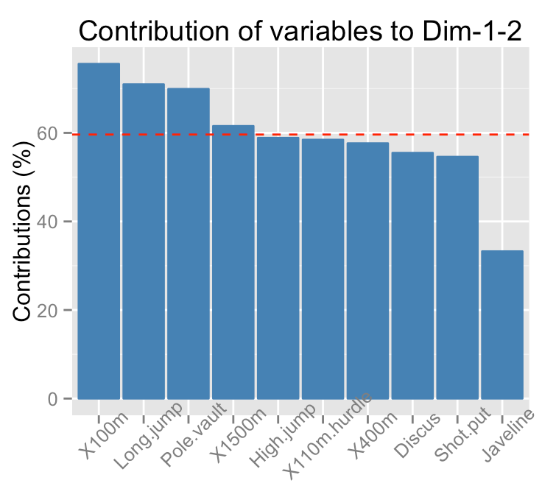
Eigenvalues → contribution

Slide 10
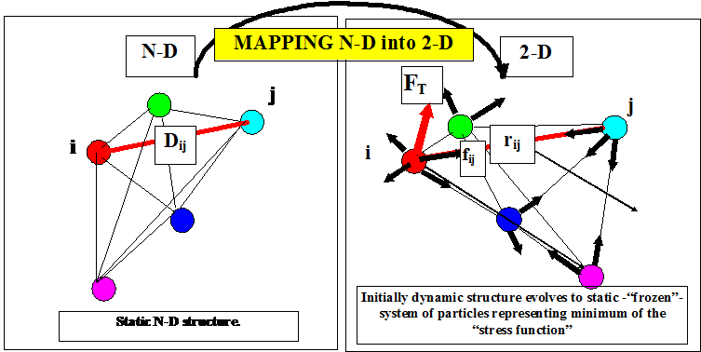
Multidimensional scaling
Dzwinel W, Blasiak J, Future Generation Computers Systems, 15, 365-379, 1999

Slide 11
Kruskal MDS and NLM
Kruskal – classic MDS
metric MDS – gradient method
2. non-metric MDS – increasing order sorted list of distances between all points pairs – position on the list → terminal distances
3. Sammon non-linear mapping (NLM)
Notes:
11

Slide 12
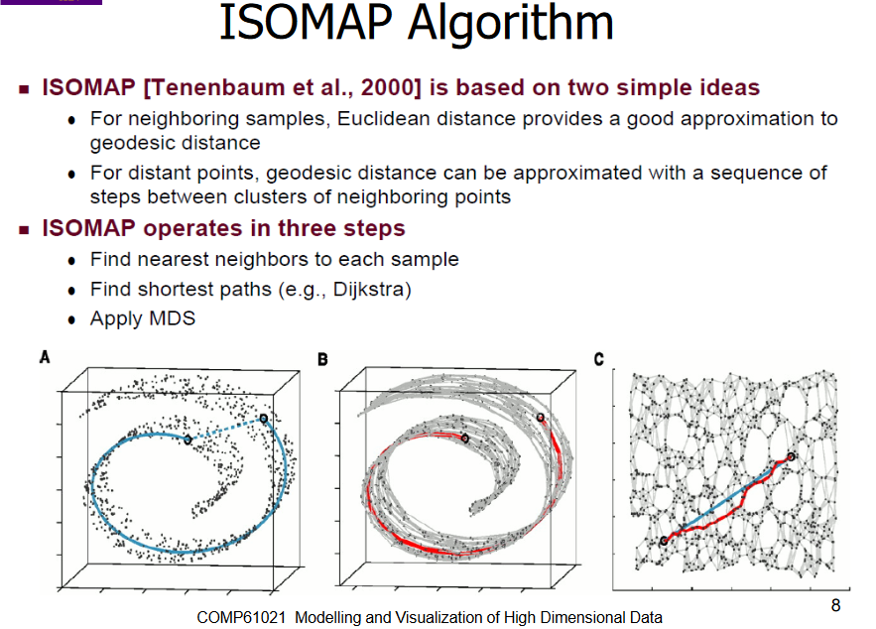

Slide 13
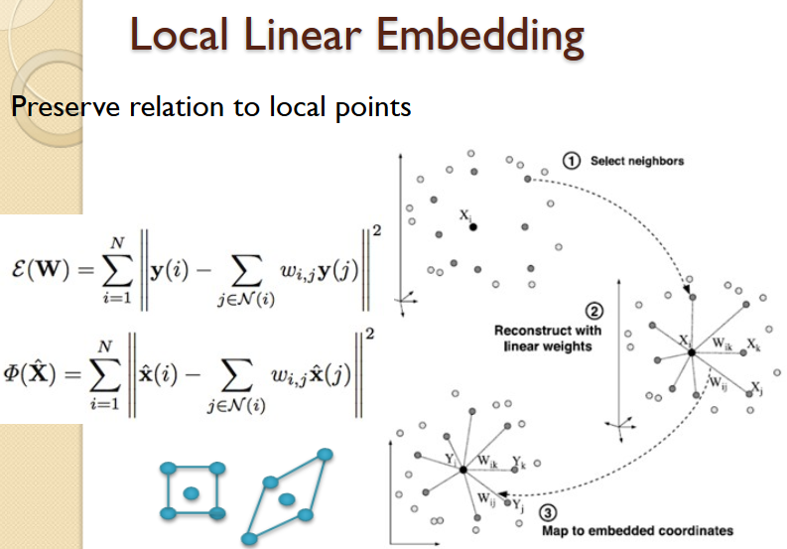

Slide 14
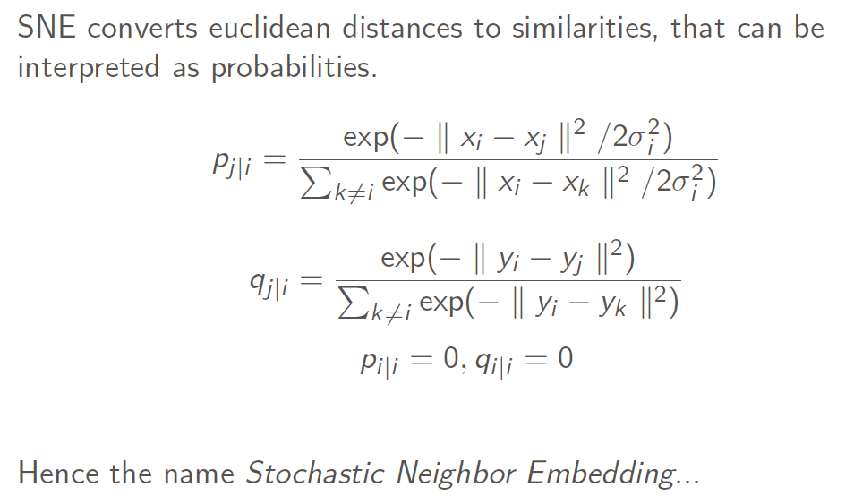
SNE Stochastic Neighbor Embedding

Slide 15
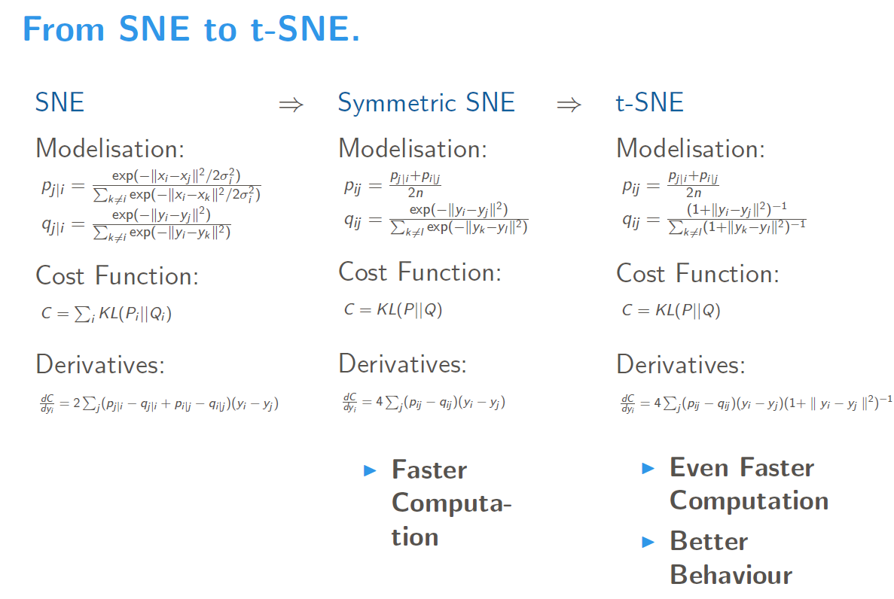

Slide 16
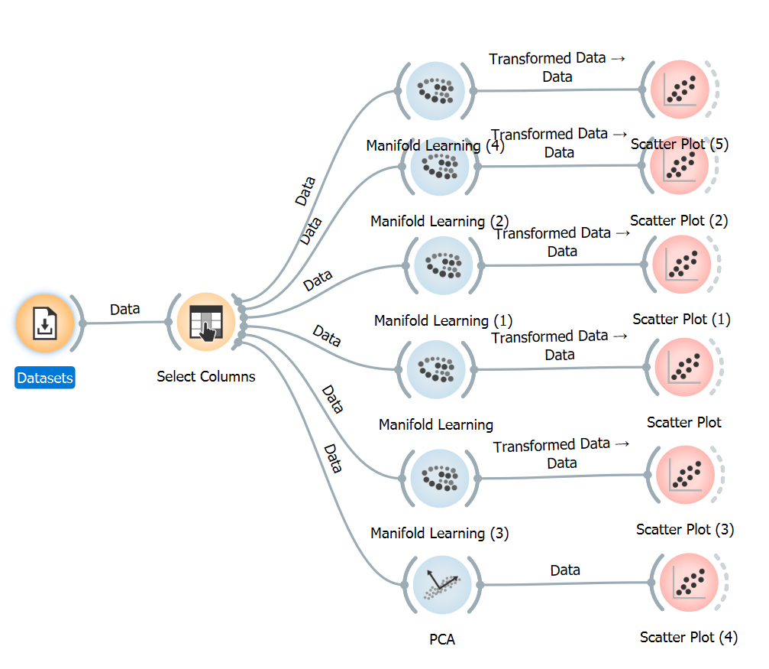
Task #1
Select an interesting data file. Read carefully its description.
What is the best embedding algorithm?

Slide 17
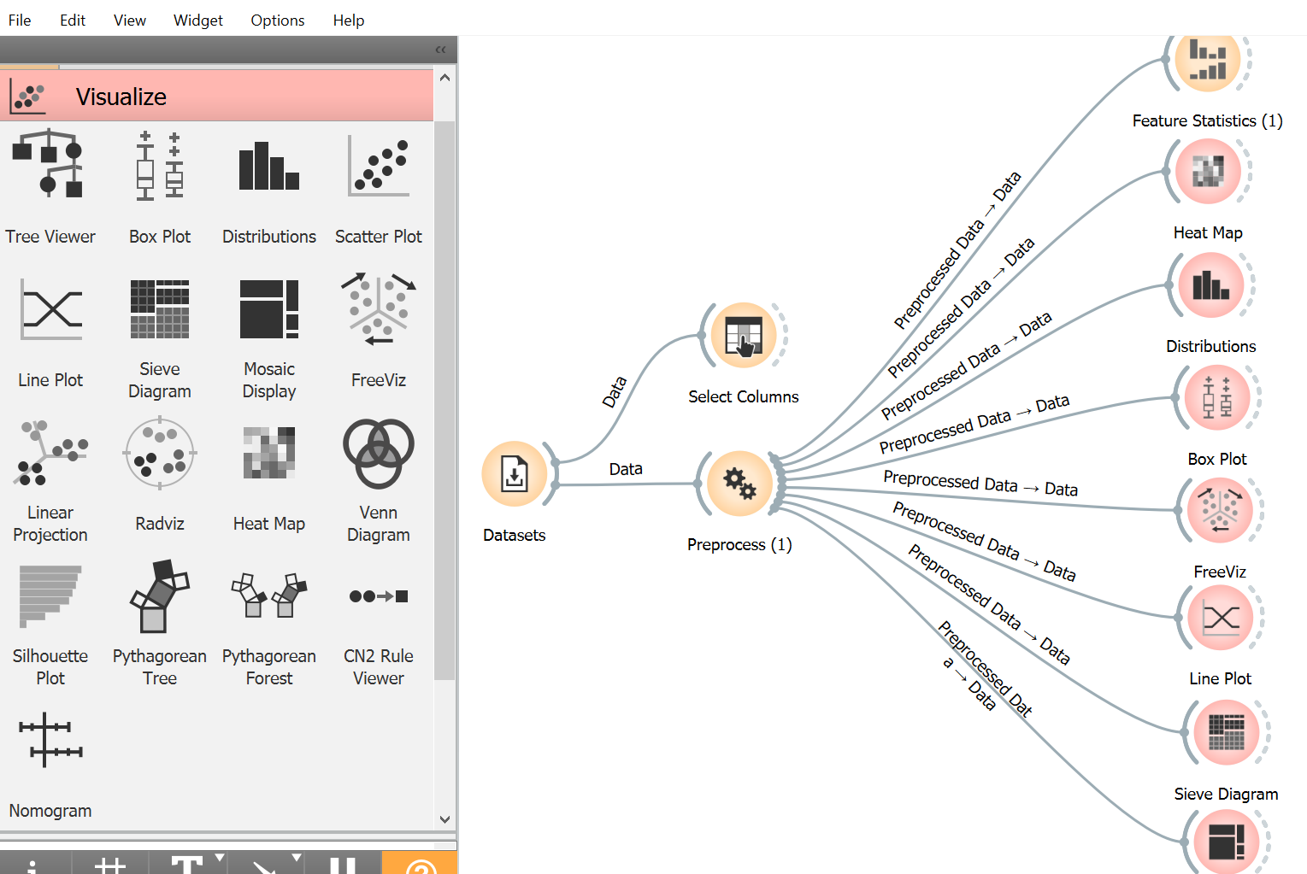
Task #2
Select an interesting data file. Read carefully its description.
What are the best features?
What are the best principal components?

Slide 18
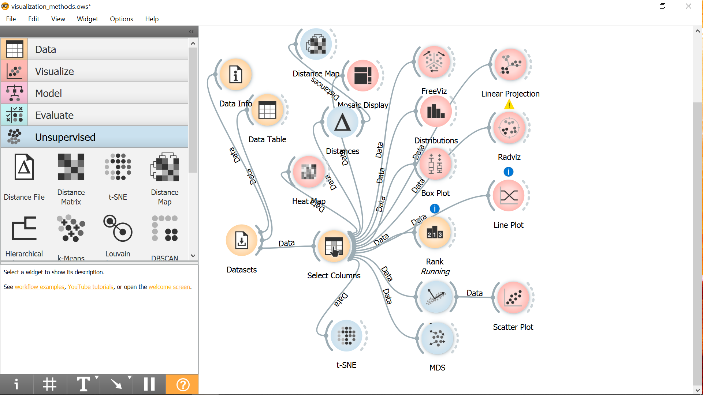
Task #3
Select an interesting data set (e.g. UCI repository
Analyze the ways of:
Feature visualization
Data visualization
Select an interesting data file. Read carefully its description.
Find the most relevant features
Visualizing the data give convincing arguments that there are really THOSE features

Slide 19
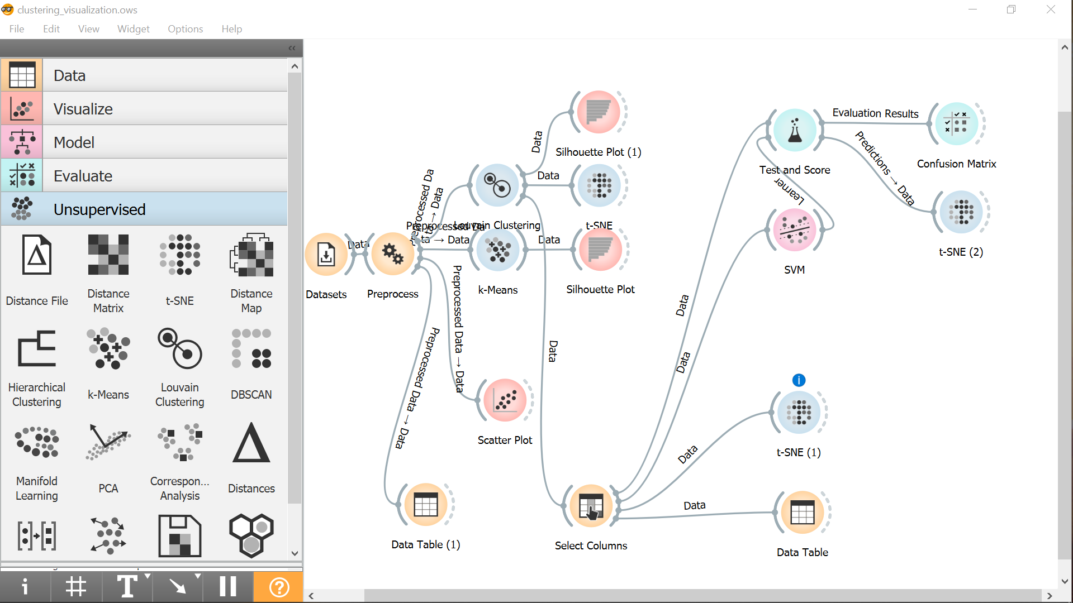
Task #4
Select an interesting data file. Read carefully its description.
Assume that the file has not classes
Use the best clustering for finding classes
Use the best classifier to reconstruct clusters
Visualize clusters/classes difference
Use confusion matrix
Task #1

Slide 20
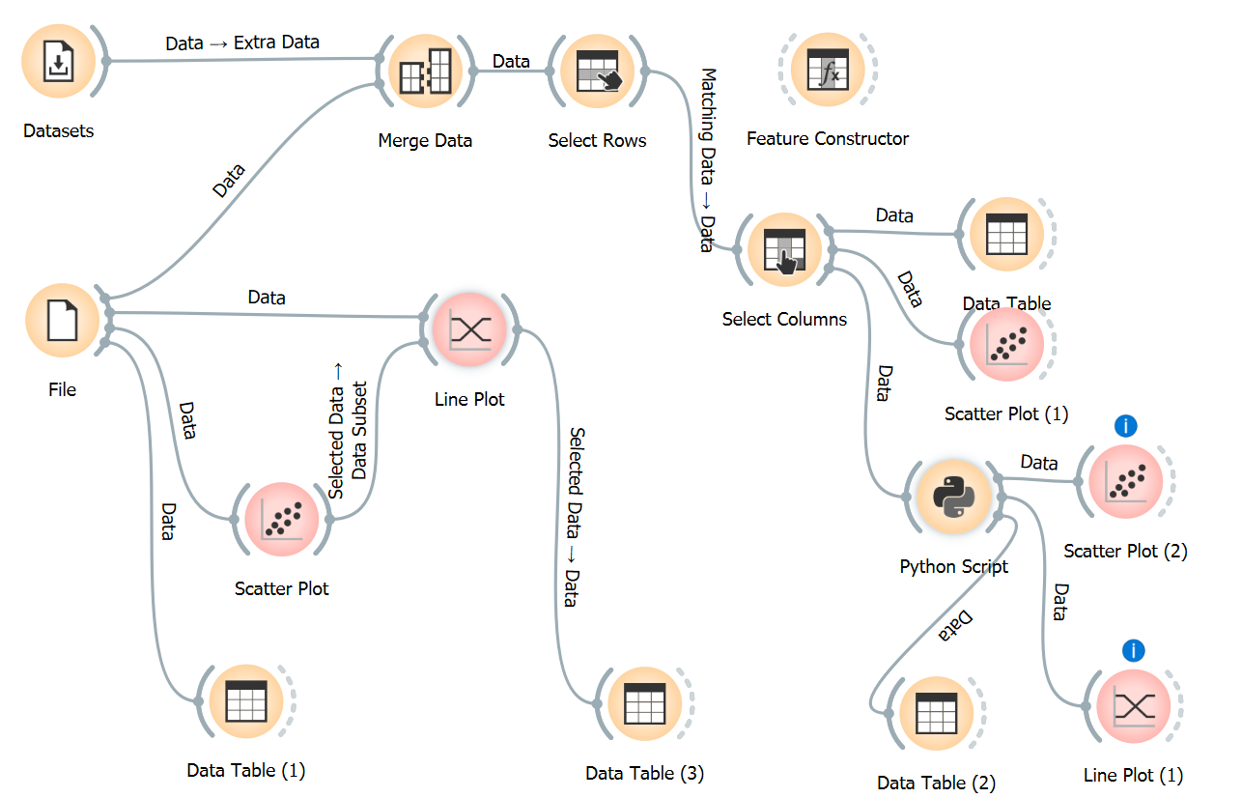
Task #5 → Covid19
Find interesting correlations between HDI and Covid19 data

Slide 21
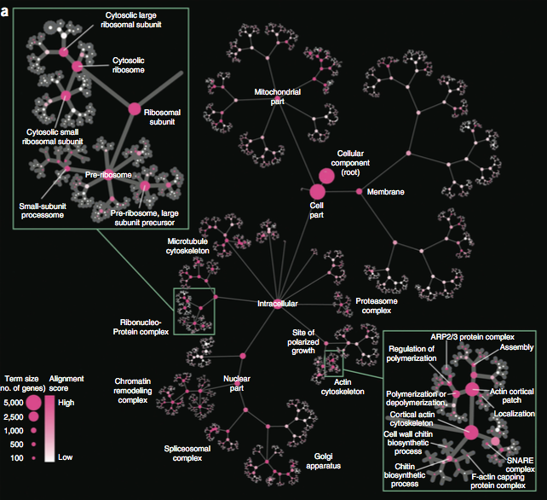
Graphs visualization

Slide 22
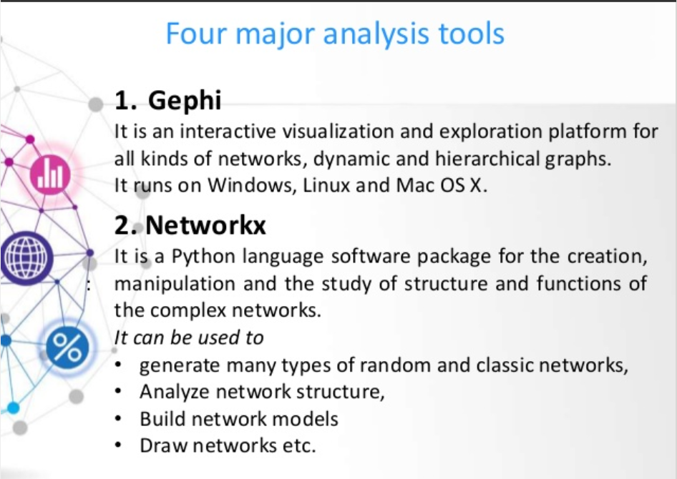

Slide 23
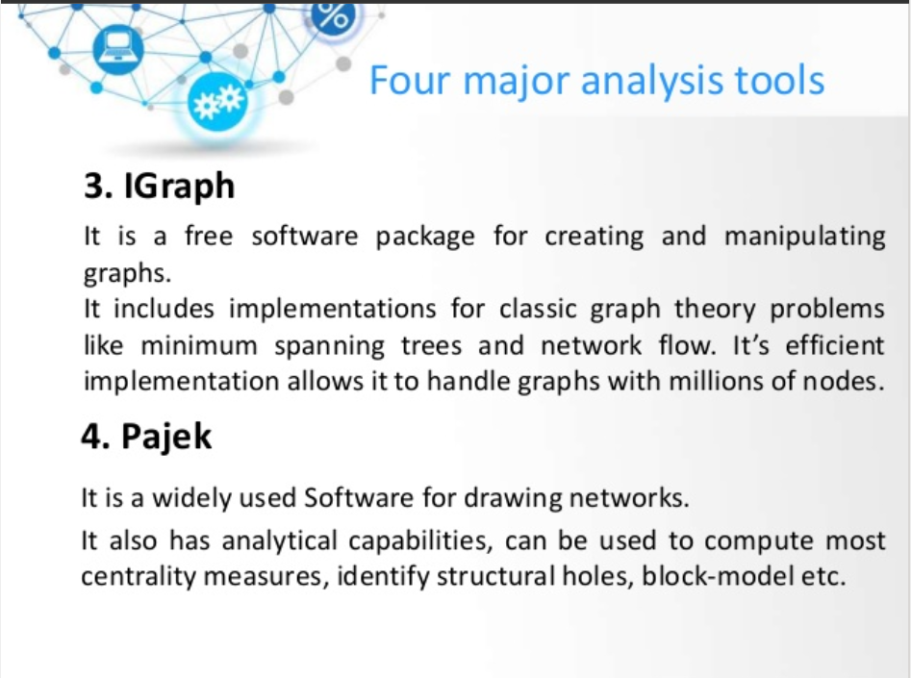

Slide 24
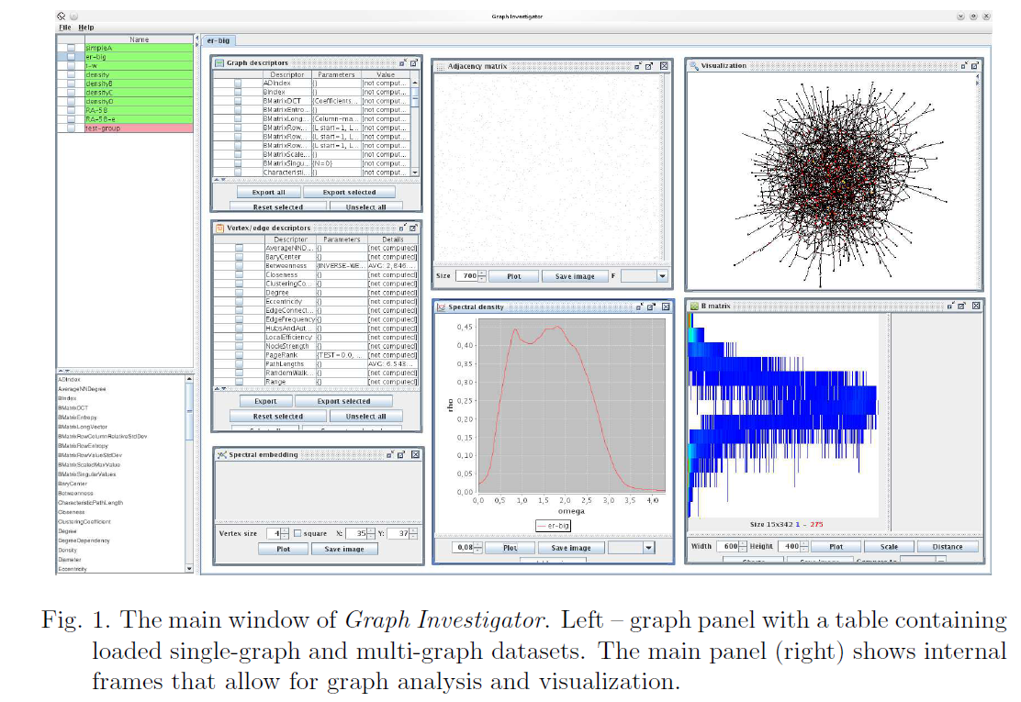
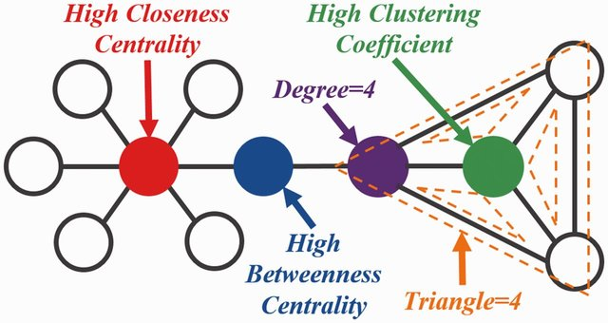
Complex network descriptors
Key Node Ranking in Complex Networks: A Novel Entropy and Mutual Information-Based Approach

Slide 25
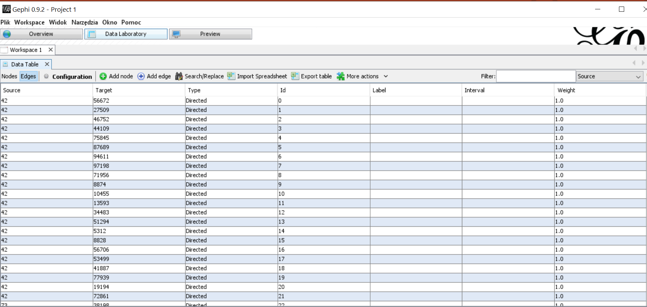
Graph representation

Slide 26
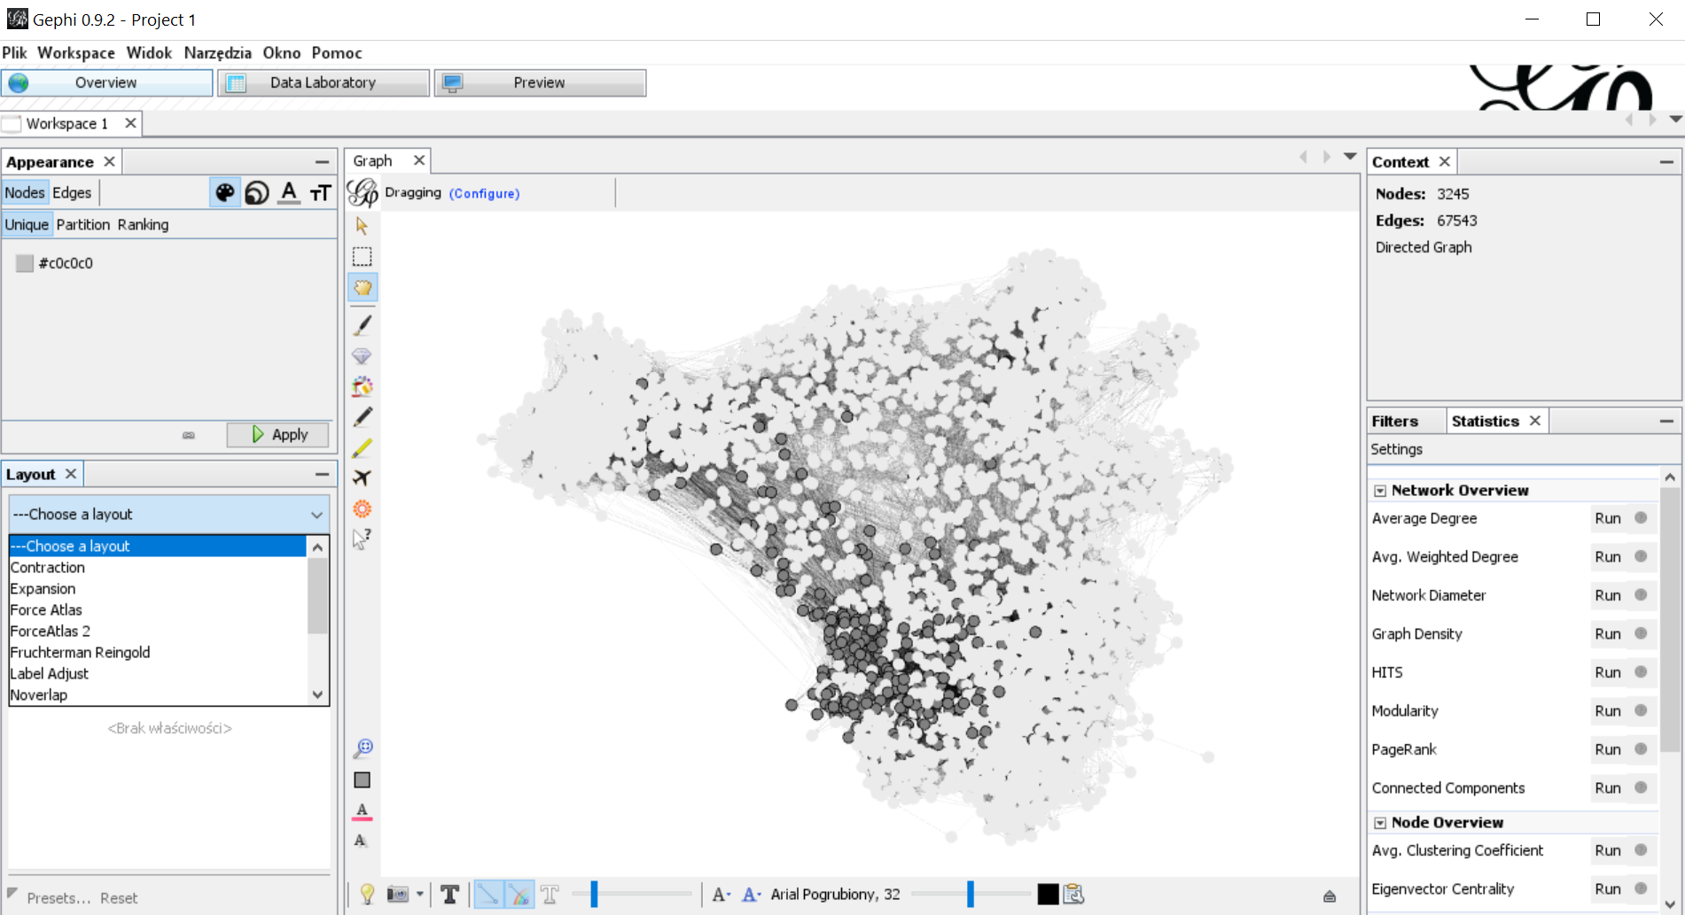
How to visualize a graph?

Slide 27
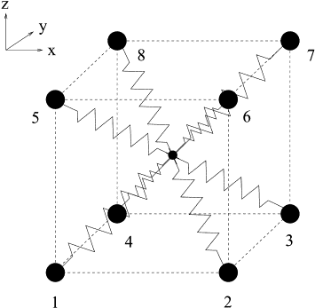
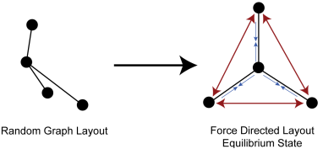
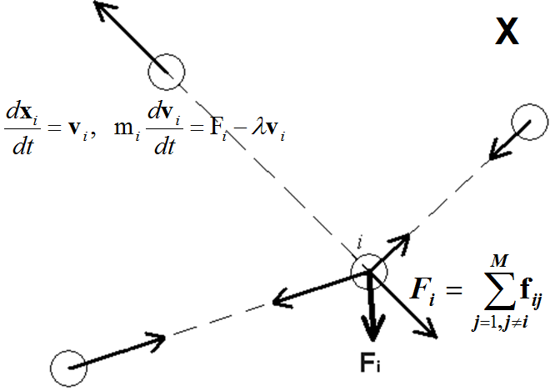
Force directed method

Slide 28
N-body simulations
v_{i}
F_{ij}
j
i
F_{ij}
(t + Δt)
i
v_{i}
(t)

Slide 29
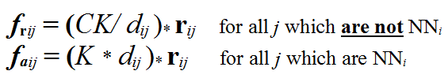

State of the art → GV
1. Force directed method (spring-electrical)
Fruchterman and Reigold [1991]
2. Not all distances computed
Burnes-Hut approximation: [Y.Hu, 2006]
3. Big GV millions of nodes and edges
The University of Florida Sparse Matrix Collection
https://sparse.tamu.edu/

Slide 30
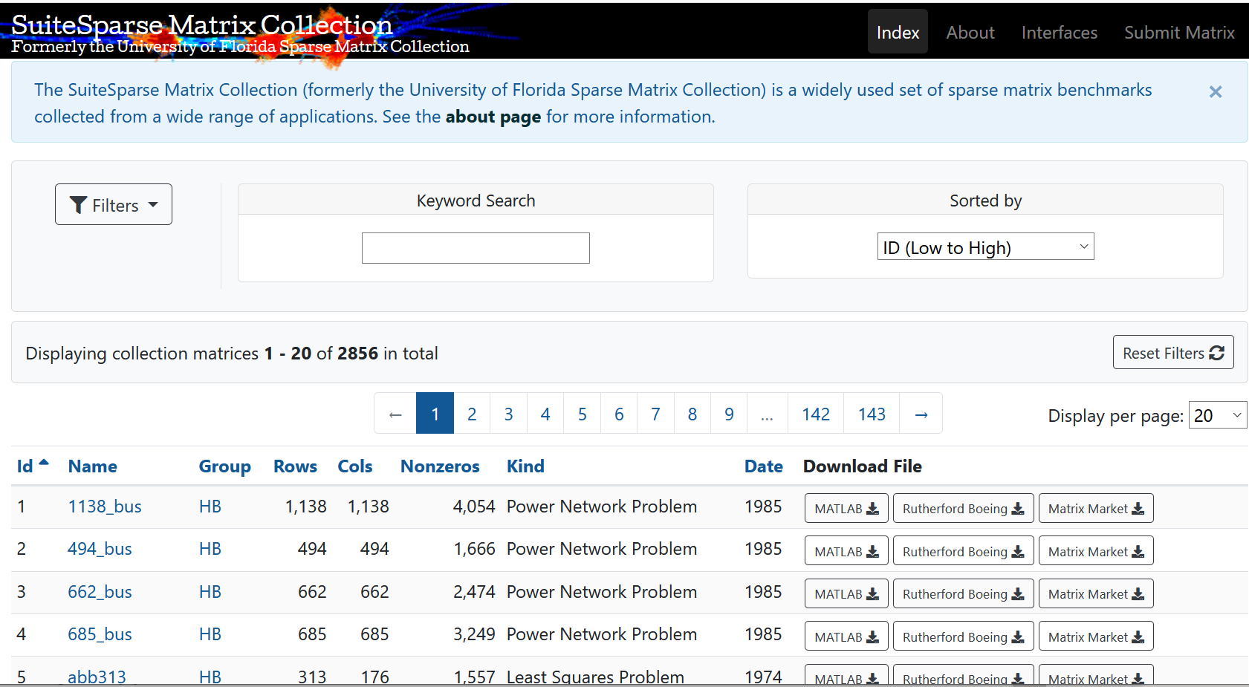

Slide 31
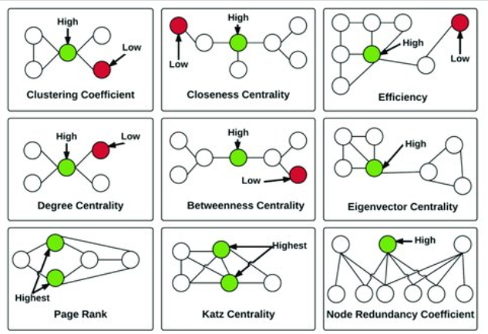

Slide 32
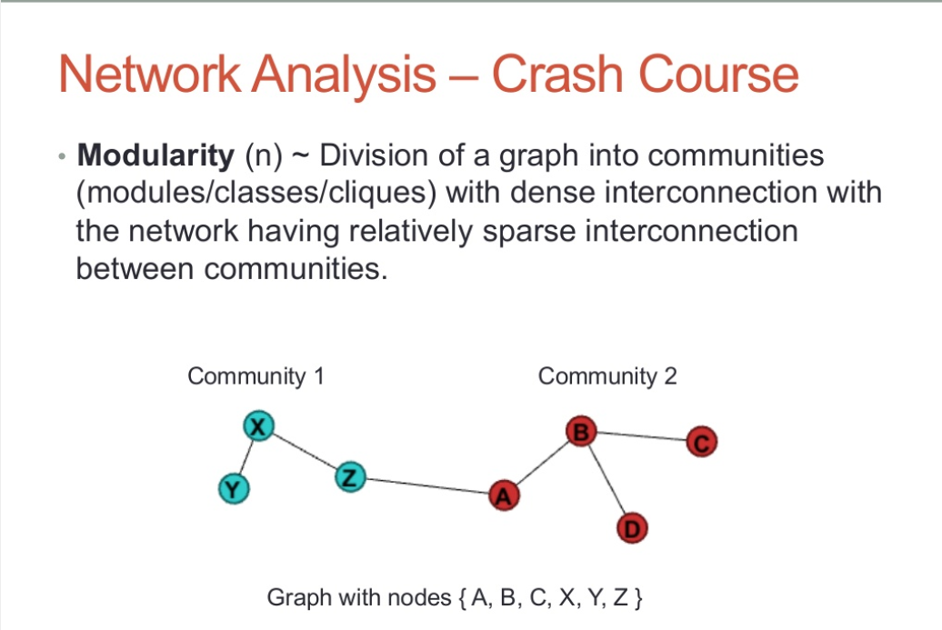

Slide 33
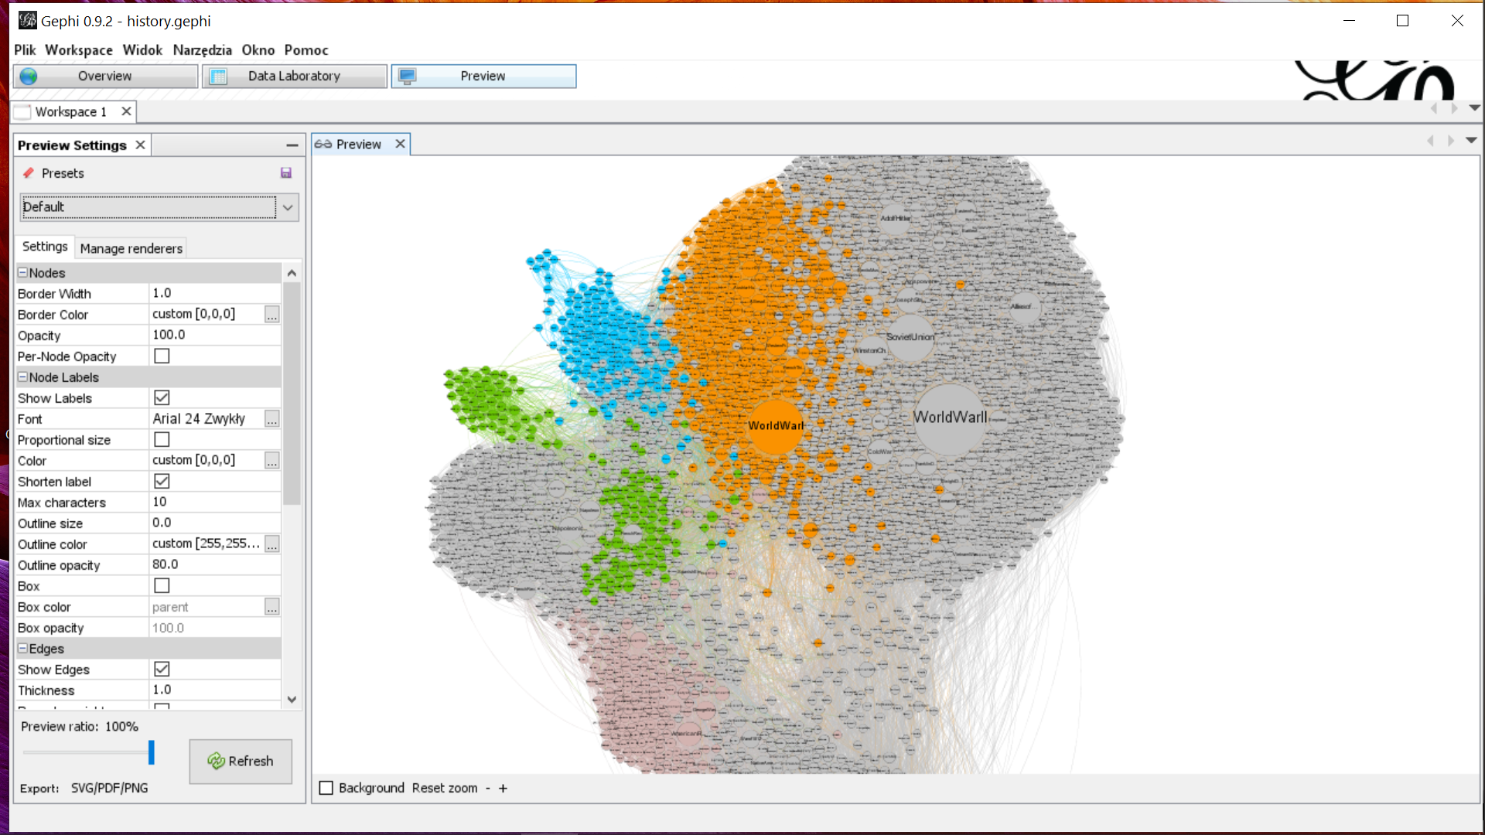
Gephi - intro

Slide 34
Task #6
Draw the best visualization of „history” (or „art” graph).
Discuss the conclusions on the basis of coarse grained and fine-grained graph features.
What the most surprising information can you conclude from visualization

Slide 35
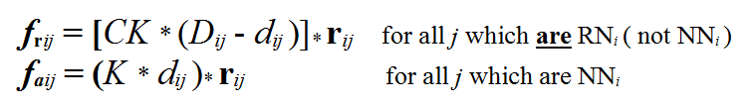
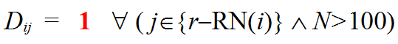
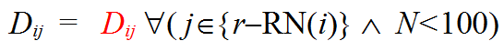
Visualize Large data → Concept
1. ∀i, find n-NN_{i} and r-RN_{i} (which are not n-NN)
2. Use force directed method
n indices of n-NN_{i} (n=2,3 for 2-D embeddings)
r indices to r-RN_{i} (r = 1)

Slide 36
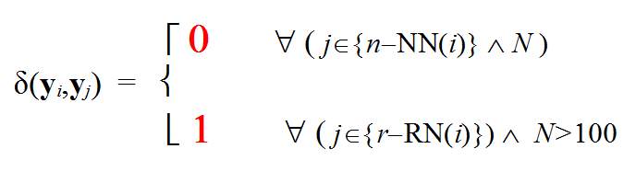
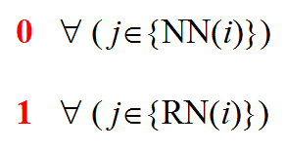
Graph visualization perspective
20NG - VE

Slide 37
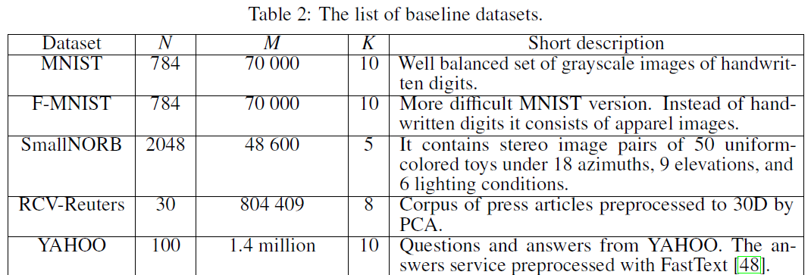
Proof of concept

Slide 38
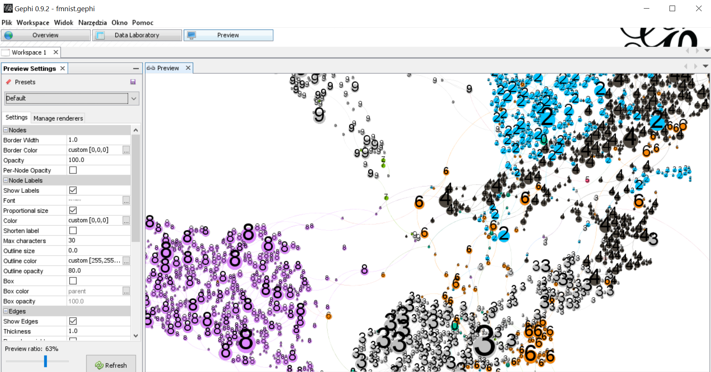
Can we use Gephi for HDD?

Slide 39
Task #7
Draw the visualization of the KNN graph representing the baseline datasets FMNIST, CIFAR 10, TNG.
Compare classes with modularities.
What can you observe?

Slide 40
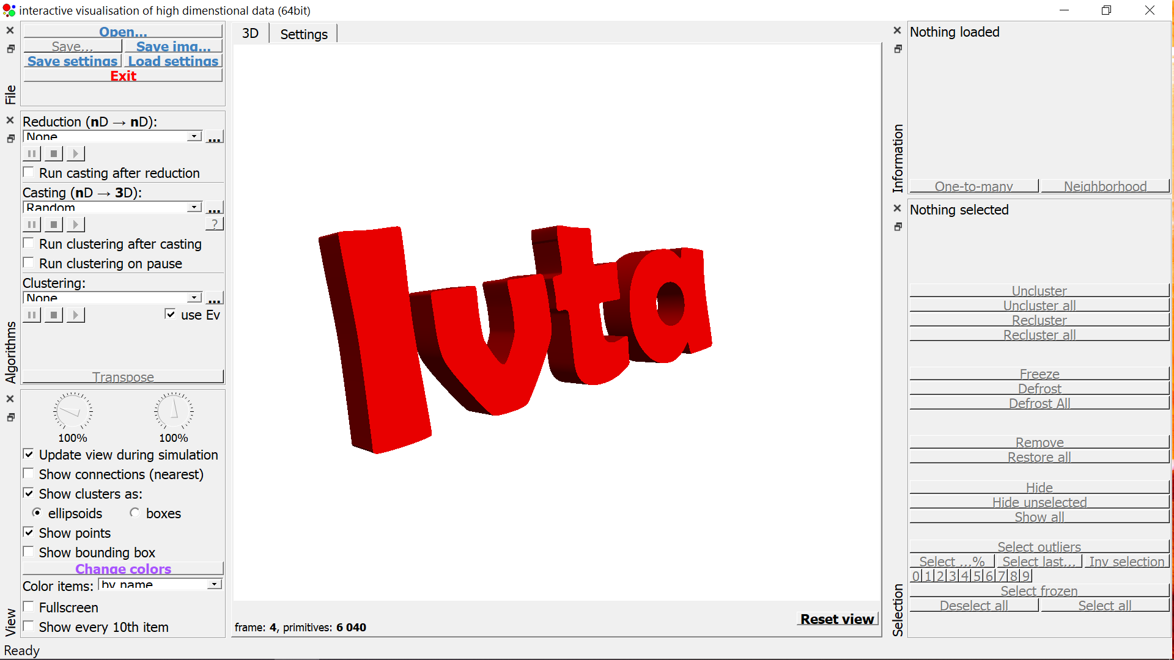
IVTA

Slide 41
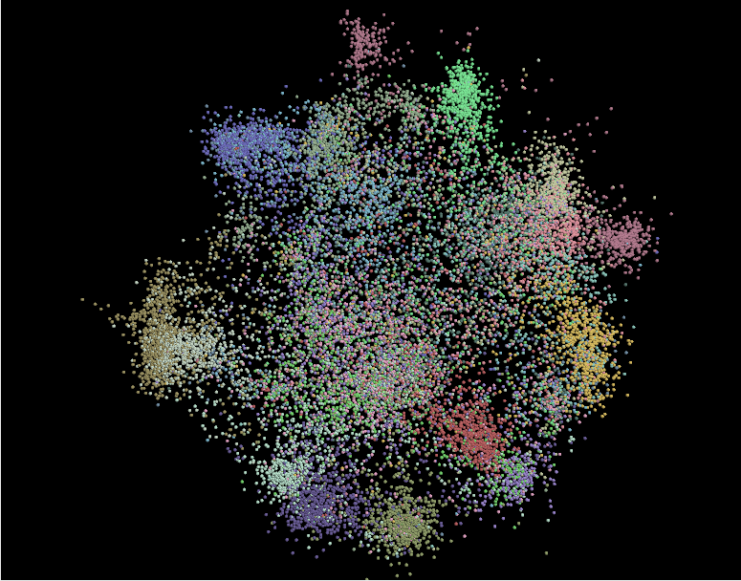

Slide 42
Task #8
For data supplied (mnist, fmist, reuters, 20ng), use IVTA to create the best 2D visualization.
Check the quality of visualization assuming that the k-nn neighbors were selected in approximate way
Discuss the conclusions

Slide 43
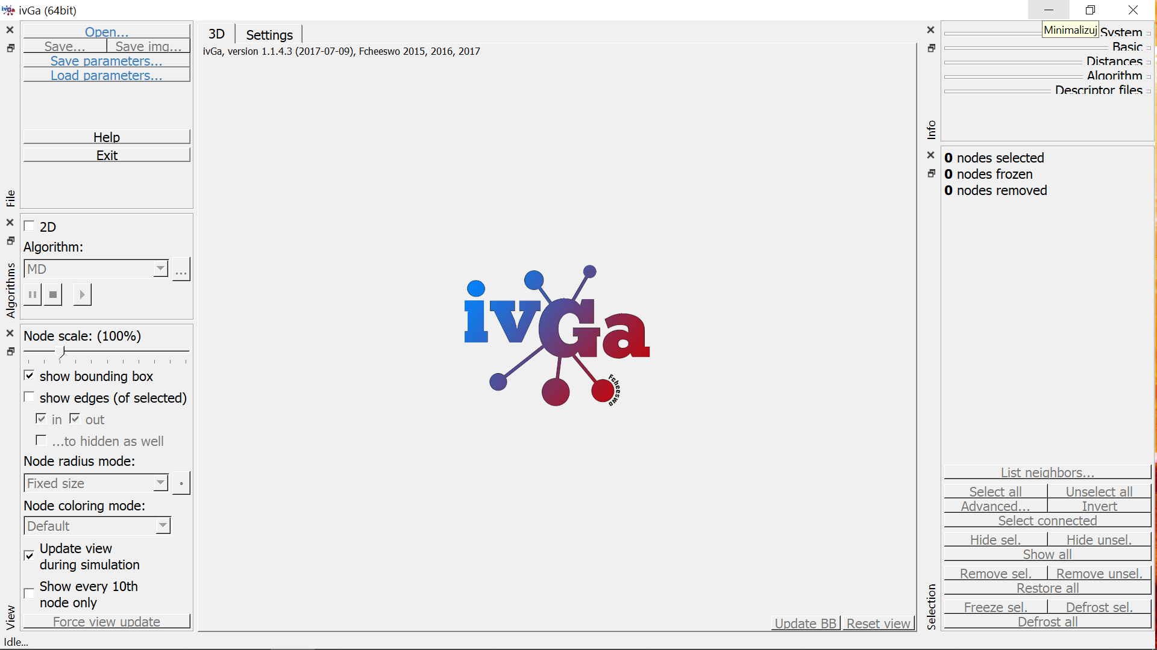
IVGA

Slide 44
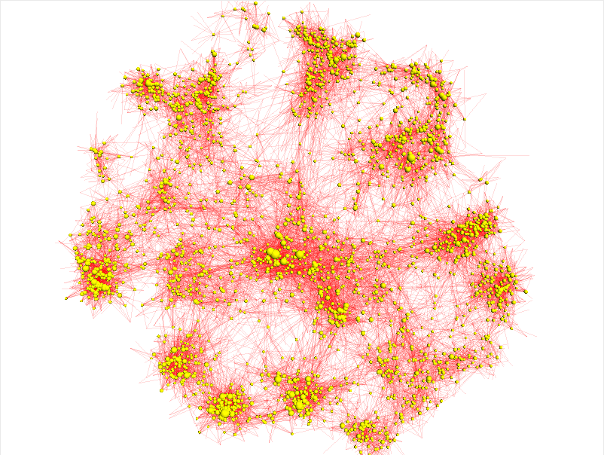
20NG - DE
20NG - GV

Slide 45
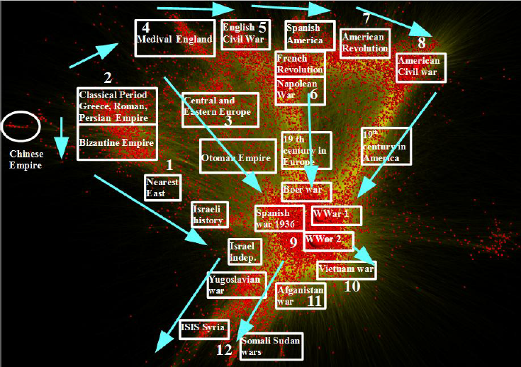
History visualization

Slide 46
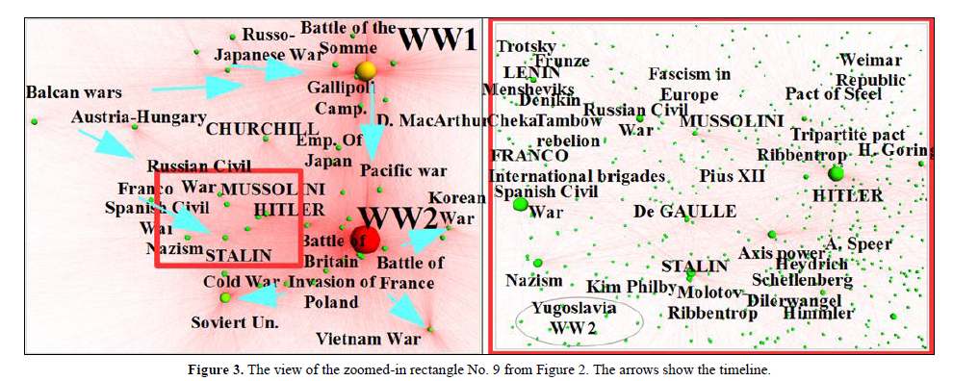
History visualization

Slide 47
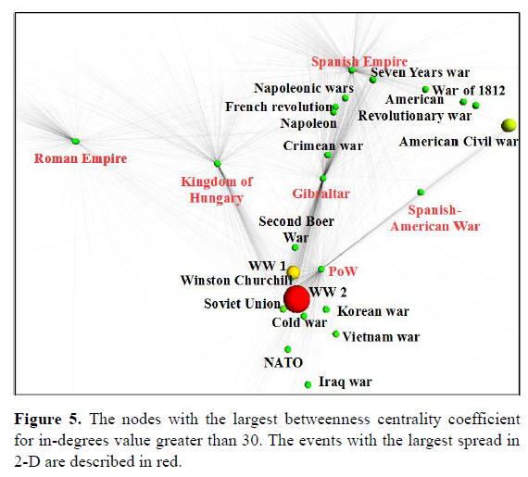
History visualization

Slide 48
Task #9
For data supplied (mnist, fmist, reuters, 20ng), use IVTA to create k-nn graph.
Check the quality of k-nn graph visualization using IVGA assuming various k. (use MD and Mdfull options)
Draw the „history” (or „art” graph). Show the varius scale of this graph checking the quality of visualization. (use MD and Mdfull options)
Discuss the conclusions

